Slide 1

Agentic AI Builder: Low-Code AI Agents & Voice Agents in n8n
Week 1
Day 3

Slide 2
3 Weeks to Agentic AI Builder
Core skills
Integrations
Projects
Week 3: Amplify with multi-agent systems and MCP
Self-hosted n8n and Local LLMs
Advanced Integrations
MCP
Context Engineering, Sub-Agents
Capstone: Amplify your business
Week 2: Accelerate with Voice Agents and RAG
Voice Agents with ElevenLabs
Integrating ElevenLabs and n8n
RAG and Agentic RAG
Supabase Vectors and Data ingest
Product Expert Voice Agent
Week 1: Automate with workflows in n8n cloud
First n8n AI Agent Live
Foundations: Agentic AI and n8n
Integrations with docs and email
Data and integrations
Daily Portfolio Rebalancer

Slide 3
n8n
Navigating n8n cloud
Cloud
“Dashboard”
“Admin Panel”
https://app.n8n.cloud/dashboard
Instance
“Home”
“Overview”
https://eddonner.app.n8n.cloud/home/workflows
Workflow
“Canvas”
“Editor”
https://eddonner.app.n8n.cloud/workflow/xxxxx

Slide 4
n8n
Some initial terminology
But we’ll mostly pick it up as we go
Node
A single step in a business process - can be a Trigger or an Action
Connection
A link - passes data from the output of one node to the input of another
Workflow
A collection of nodes connected together to automate a process
Execution
A single run of a workflow; can be Manual (testing) or Active (production)
Templates
A prebuilt workflow that you can use as a starting point

Slide 5

API CHARGES
Recap: Integrations
You are in control! No need to spend anything.
You don’t need to pick the same integrations as me - feel free to experiment and explore
Integrations can be a pain. Check the docs; plenty of patience may be needed
All integrations are optional and most have free tiers

Slide 6
3 Weeks to Agentic AI Builder
Core skills
Integrations
Projects
Week 3: Amplify with multi-agent systems and MCP
Self-hosted n8n and Local LLMs
Advanced Integrations
MCP
Context Engineering, Sub-Agents
Capstone: Amplify your business
Week 2: Accelerate with Voice Agents and RAG
Voice Agents with ElevenLabs
Integrating ElevenLabs and n8n
RAG and Agentic RAG
Supabase Vectors and Data ingest
Product Expert Voice Agent
Week 1: Automate with workflows in n8n cloud
First n8n AI Agent Live
Foundations: Agentic AI and n8n
Integrations with docs and email
Data and integrations
Daily Portfolio Rebalancer

Slide 7
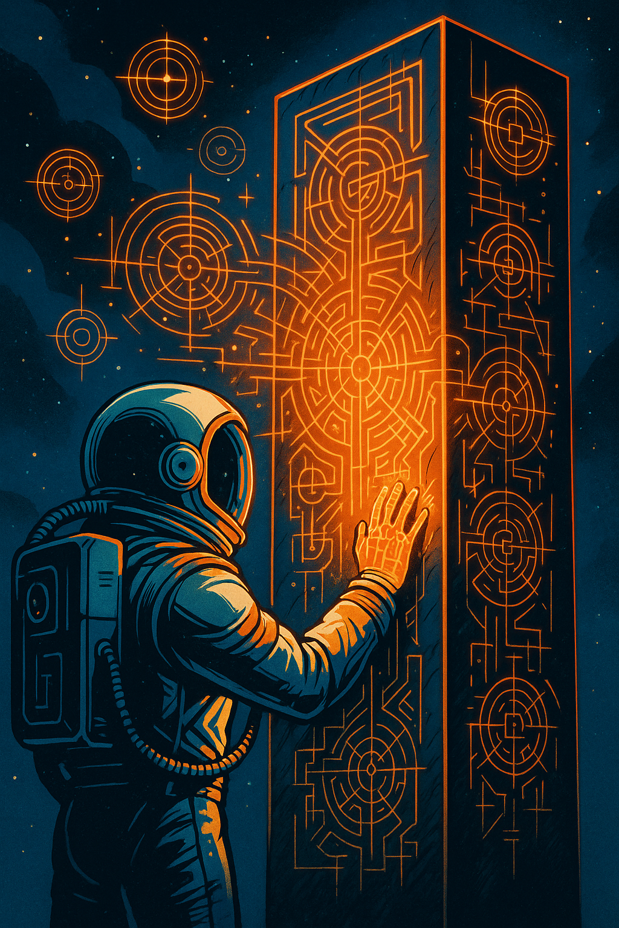
Agentic AI Builder: Low-Code AI Agents & Voice Agents in n8n
20%
Complete

